Slide 1
Biomolecules

Slide 2
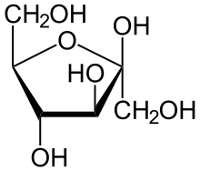
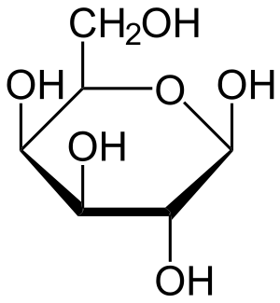
Carbohydrates – Sugars and Starches
Glucose
Fructose
Galactose

Slide 3
Cellulose
Strong Molecules used in plant cells
The green cleaner in between the white beads represents the bonds between monosaccharides in cellulose polymers
These bonds are very strong and cause this polysaccharide to be indigestible for most animals, including humans.

Slide 4
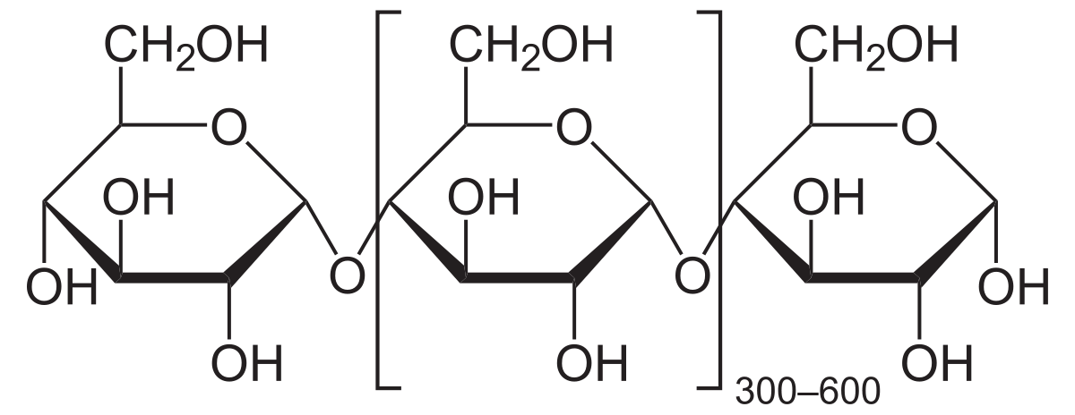
Starch
Strong storage molecules used in plant cells
White pipe cleaner in between the white beads represent the bonds between monosaccharides in starch polymers, these bonds are relatively weak and can be broken easily
Animals can break down(or digest) starch molecule into small mono saccharides that animals cells can use for energy.
Foods high in starch: Peas, potatoes, corn, beans, rice, grains

Slide 5
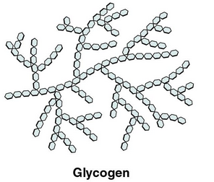
Glycogen
Sugar storage molecule used in animal cells
2 Red pipe cleaner with white beads(which represent glucose). Creating a branched structure
Animal cells store glycogen in specialized cells. They store this long branched chain of glucose molecules so they can quickly break down when need extra energy.
Places where animals store glycogen in their bodies: liver and muscle cells.

Slide 6
Carbohydrate structures

Slide 7
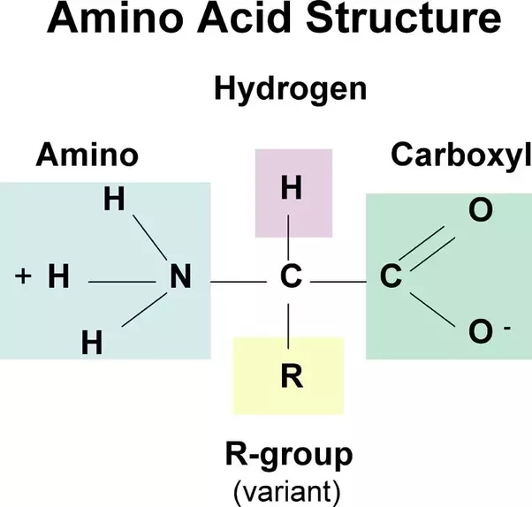
Proteins
Bead represent the different amino acids
All amino acids have a similar structure

Slide 8
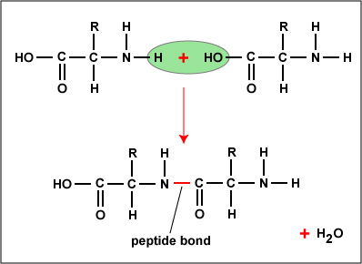
Peptide bonds
Dehydration synthesis: when two amino acids form to make a larger biological molecule.
As two amino acids bond together a peptide bond is formed along with a molecule of water

Slide 9
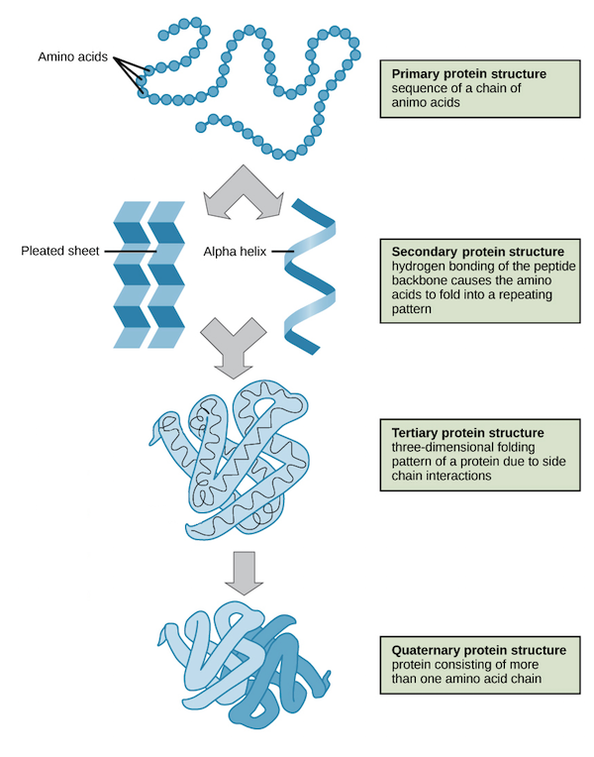
Protein Structures
Primary Structure: the sequence of your amino acids in your polypeptide.
Secondary structure: bend your polypeptide to form a helix.
Tertiary structure: Fold and scrunch up your helical peptide into a ball shape. Creating a more complex structure.
Quaternary structure: multiple-polypeptide proteins
Folding two or more polypeptides folded and wrapped together

Slide 10
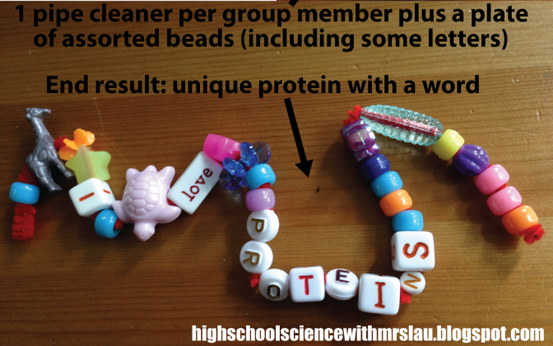
Proteins
Cells use proteins to do jobs around the inside and surface of the cell. Each protein has a specific function. Sometimes proteins only need one polypeptide change to work properly. Often proteins need more than one polypeptides chain to work properly.

Slide 11
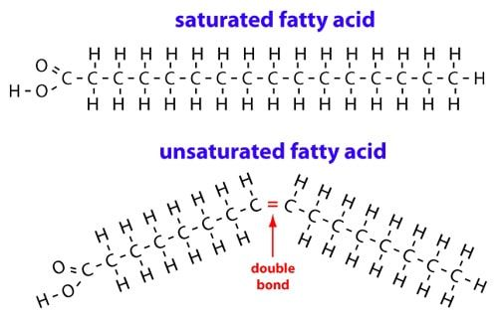
Lipids
Saturated and Unsaturated
Bonds between carbon atoms and other carbon atoms store a lot of energy.
Long strands of carbon

Slide 12
Lipids Structure
Carbon backbone
Carbon and hydrogen tails

Slide 13
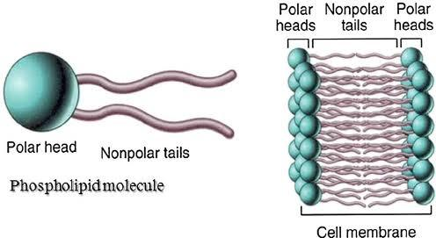
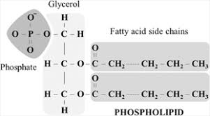
Phospholipids
A phospholipid is made of tow fatty acids and a phosphate group connected to a glycerol molecule.

Slide 14
Lipids

Slide 15
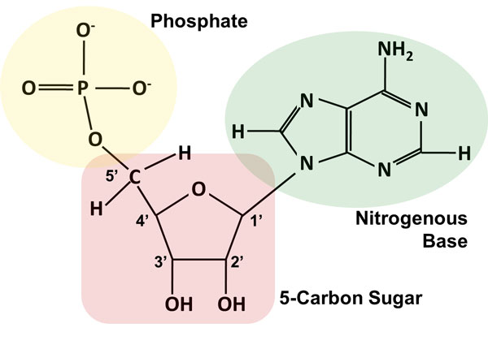
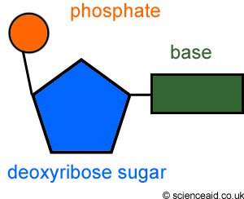
Nucleic Acids
Nucleotides: phosphate group, sugar, and a base

Slide 16
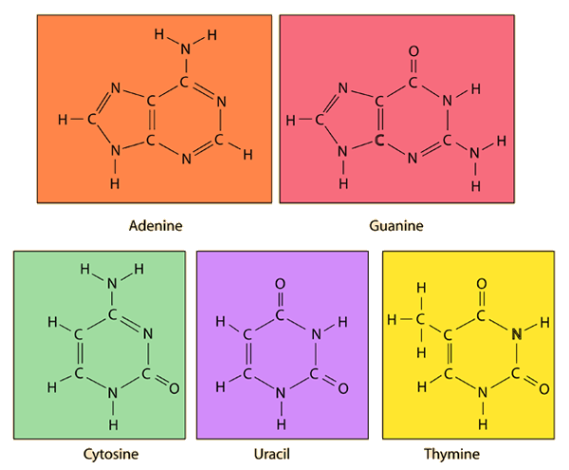
Nitrogenous Bases
Adenine
Guanine
Cytosine
Uracil (RNA)
Thymine

Slide 17
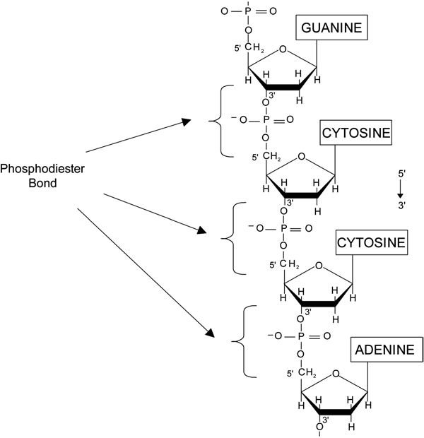
Polymers of Nucleic Acids
Two types of polymers
Ribonucleic Acid(RNA)
Deoxyribonucleic acid (DNA)
Bonds that hold the nucleotides together on the same strand are called phosphodiester bonds

Slide 18
