Slide 1
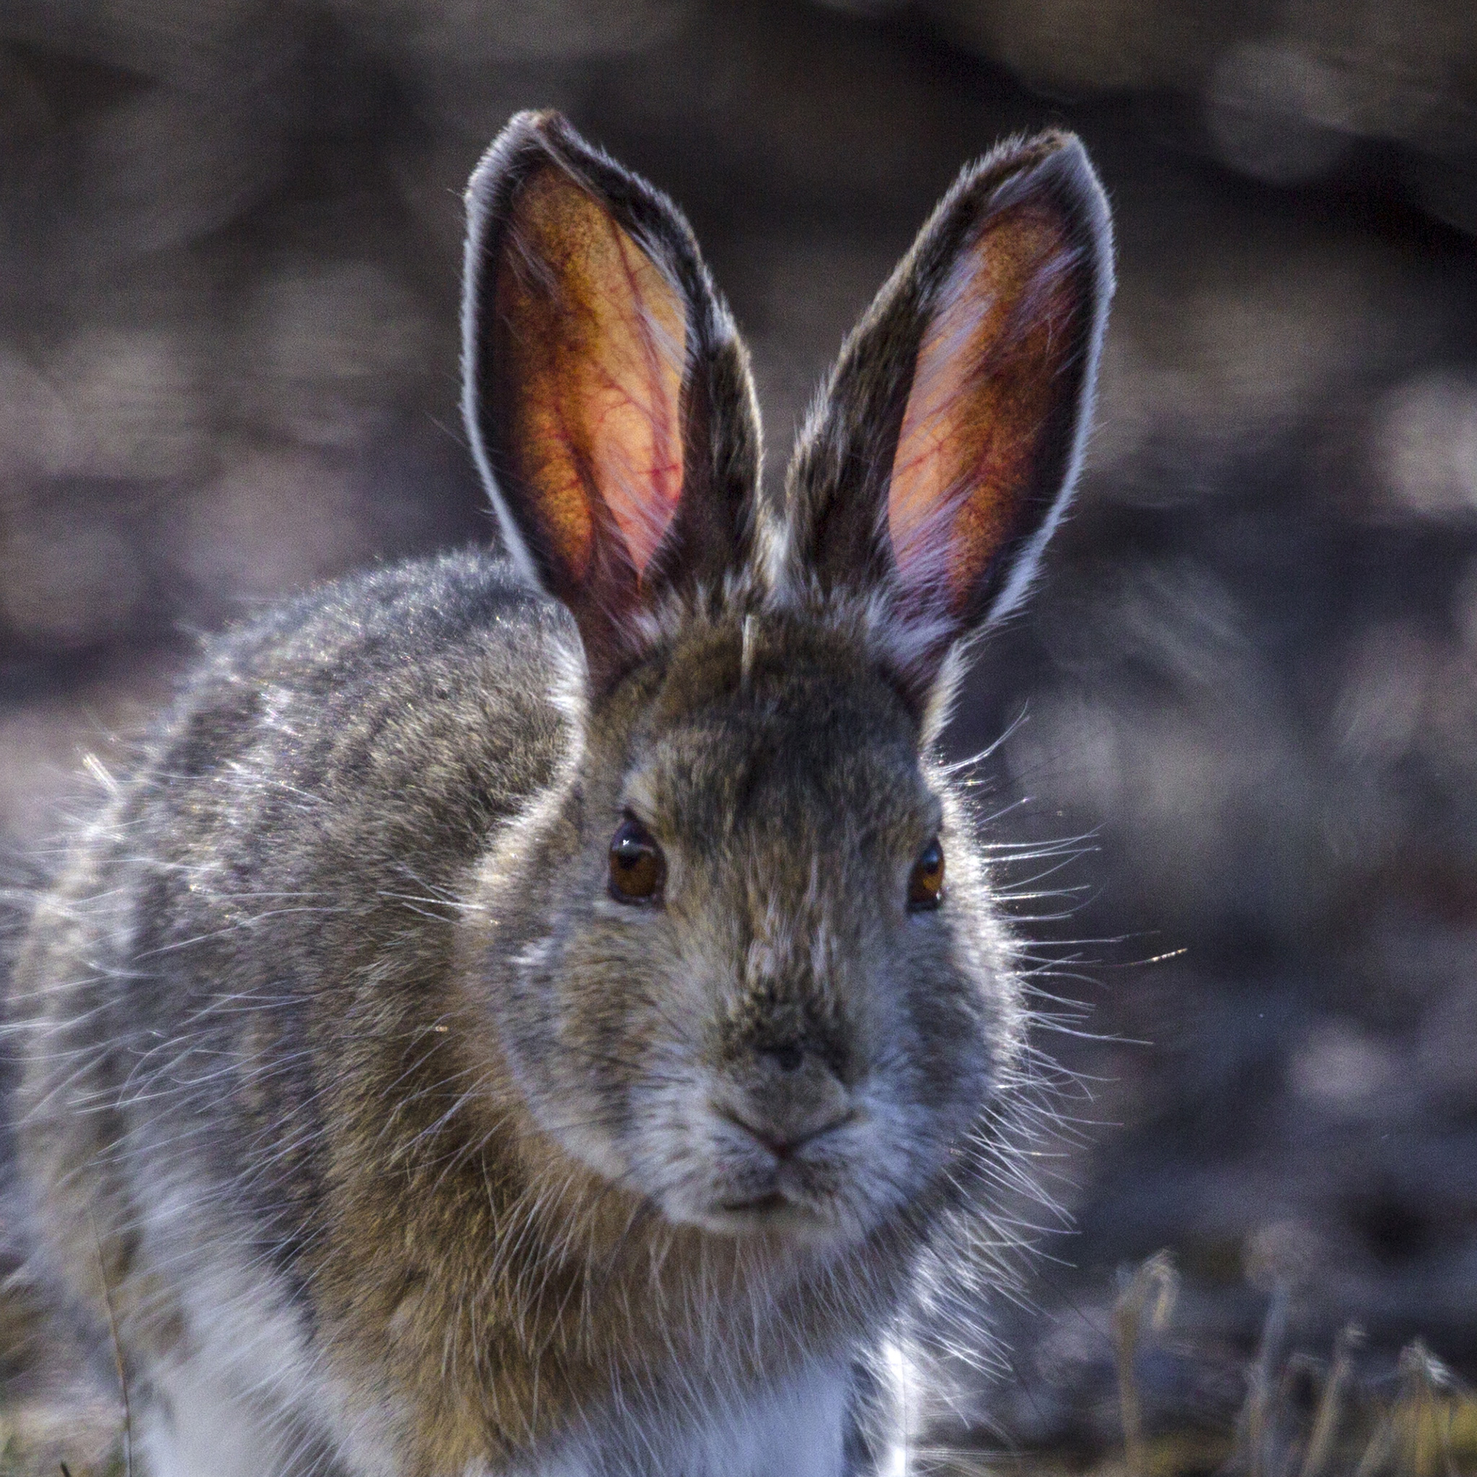
Snowshoe Hares
What is happening?

Slide 2
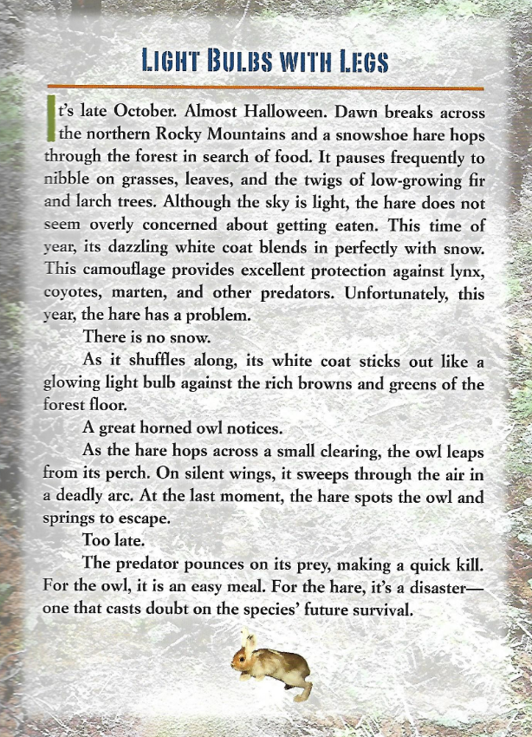

Slide 3
Snowshoe hares in 1998
A wildlife biologist at the University of Montana, Scott Mills first took an interest in snowshoe hares in 1998. Scott applied for and received grant money to study snowshoe hares in Montana. “Hares don’t die of old age,” Scott explains. “Anything that eats meat in the forest feeds on snowshoe hares. Coyote, foes, bobcats, lynx, owls, goshawks, weasels, marten, fishers – everything. I call hares the candy bar of the forest, but my students call them the cheeseburger of the forest. Most hares live only a year or less.
More than anything, hares blend in with their surroundings. Most of the year, their brown coats match the brown forest floor. In autumn, shorter days trigger their coats to change, or molt, from brown to white. This camouflages hares against the white, snowy background of the oncoming winter. In the spring, when the snows melt, the hares molt back to brown.

Slide 4
Disturbing discovery
After studying hares for four or five years, however, Scott noticed something disturbing. “I’d be out there in the spring, following hares around, and I’d find a brilliant white hare sitting on brown, bare earth. It was obvious the thought it was protected by its camouflage.
This led Scott to wonder, “As climate change gets worse and winters grow shorter, will predators take a bigger and bigger toll on snowshoe hares? Will the species be able to survive?

Slide 5
Problems with fossil fuels
When burned, fossil fuels release carbon dioxide and other gases into Earth’s atmosphere. These “greenhouse gases” trap heat, driving up our planet’s temperatures. The effects of climate change vary from place to place. Climate scientists, however, observe one trend almost everywhere on the planet: less snow cover. Almost everywhere, there is a decrease in the duration of snowpack.

Slide 6
The winter season, with snow on the ground, is on average two to three weeks shorter than the snow cover period fifty years ago.

Slide 7
Scientific questions
Scott asked several scientific questions about hares.
Were hares really mismatched: In other words, did hares with white coats find themselves sitting on brown backgrounds for any significant lengths of time – and did brown hares find themselves sitting on white backgrounds?
Were mismatched hares more likely to get eaten than hares that were camouflaged?
Were hares even aware of their mismatch, and if so, did they do anything about it?
As Earth’s temperatures grow warmer, would hare mismatches increase?

Slide 8
Scott’s Findings
During the three-year study, Scott and his team found that, on average, a hare spent about a week mismatched. A huge problem, Scott and his team found, is that the hares did not seem to know when they were mismatched. The hares seemed to trust in their camouflage, even if they weren’t camouflaged. They found that the start and finish dates of the molts depended almost solely on the length of daylight hours. They discovered that hares had some ability to shift both the timing and speed of their spring molts, but not in the fall. Unfortunately, the hares’ ability to make small adjustments in spring still isn’t enough to keep them from ending up mismatched. If climate change continues to get worse, as most scientists predict, what will that mean for the hares? When Scott and his team looked at predictions of carbon dioxide and other greenhouse gases in the atmosphere, they found a dramatic increase in the number of days snowshoe hares will be mismatched.

Slide 9
Mismatch
Predictions
based on
current
information

Slide 10
Questions and answers
Question: Is there any chance that snowshoe hares and other coat-color-changing animals will survive future changes in climate?
More than twenty species of animals, from lemmings, weasels, and hamsters to Arctic foes, ptarmigans, and other hare species change their coat colors each fall and spring.
Surprisingly, Scott Mills is optimistic that hares and other species with seasonal coat color changes will find ways to survive. Scott believes that over time, the snowshoe hare species will evolve, or adapt, so that the timing of its molts better matches the changes in snow conditions. Only when individuals reproduce and pass on their better mix of genes does it change the species – and only then, does evolution take place.

Slide 11
Scientific studies
Scott and his colleagues have launched several projects to study other species and populations that change their coat colors with the seasons. Dr. Eugenia Bragina is examining museum specimens to see what animal coat colors were like in the past. Scott and his team are working with scientists in Portugal, Ireland, Austria and Sweden to investigate the molt timing of animals. Other studies will look at the actual genetics of animal populations. Molting is a complex traits that involves multiple genes.
Scott has built a lab consisting of four rooms in which he and his team can control day length and temperature. They put two frame on the floor; one with soil and pine needles and one with artificial snow. Scott also hopes to breed some hares to discover more about their genetics and their ability to adapt to environmental changes.

Slide 12
While it is certain that temperatures will continue to rise, Scott and other scientists also believe that there is a lot humans can do to help hares and other animal species.

